Slide 1

Acceptance Test Driven Development
Quality-First Workflow with JIRA & X-ray
(parts generated by Gemini)

Slide 2
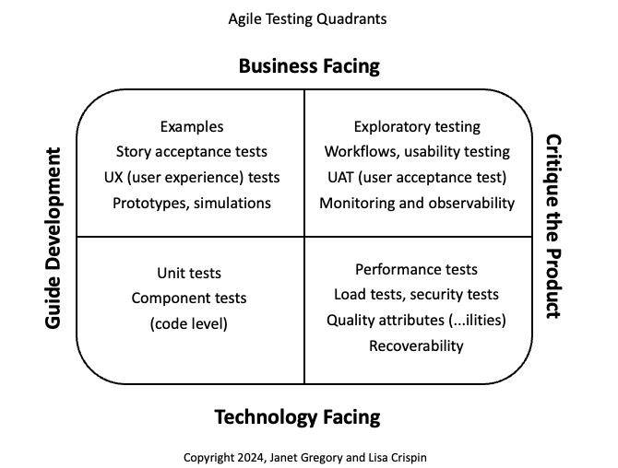


Slide 3



What is Acceptance Test-Driven Development?
Collaborative Approach
Specification by Example
ATDD moves testing to the beginning of the development cycle. It brings Developers, Testers, and Product Owners together to define "Done" before a single line of code is written.
Instead of vague requirements, we use concrete examples (Scenarios) to describe behavior. These examples become our Living Documentation and our automated test suite.

Slide 4
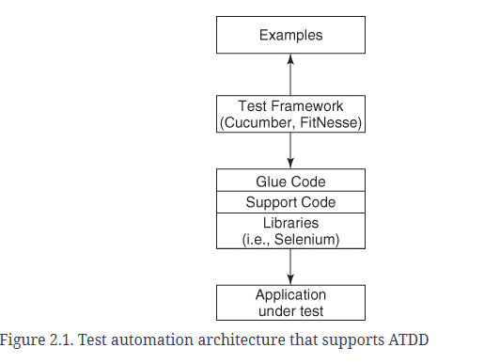

Slide 5

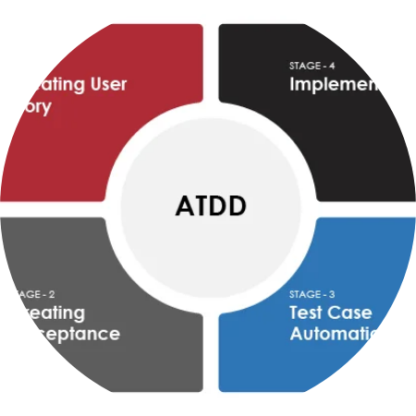
The 4 D's of ATDD
Discuss: Talk about what we are building (User Stories).
Distill: Convert discussions into testable specs (Gherkin).
Develop: Write code to make the tests pass (TDD).
Demo: Show the working feature to stakeholders.

Slide 6


Step 1: Discuss
The "Three Amigos"
This phase involves a meeting between the core roles to align on the User Story.
Product Owner: Defines the "What" and "Why".
Developer: Discusses technical feasibility.
Tester: Probes edge cases and "What ifs".

Slide 7
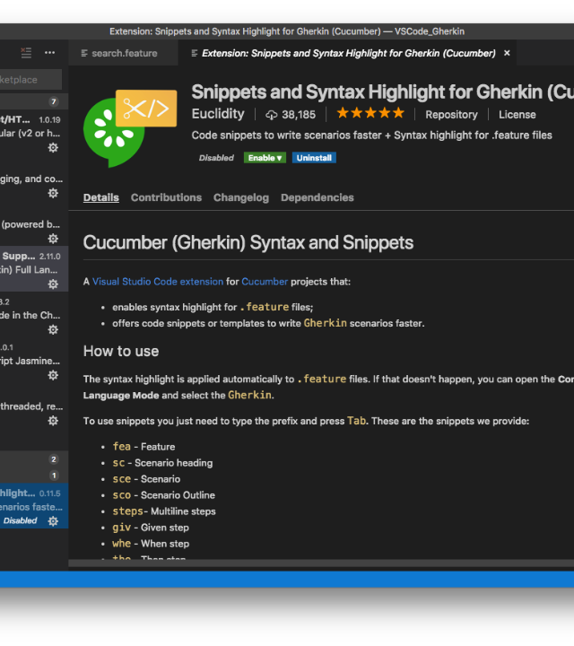
Step 2: Distill feature
In JIRA, we translate our examples into an executable format.
Create a JIRA Issue of type "Test".
Set Test Type to "Cucumber".
Link this Test to the User Story using the "Tests" link type.
Write the scenario in the Scenario field using Gherkin syntax.
OR: automatize as regular test and push the results back to JIRA.

Slide 8







The JIRA Structure
User Story
X-ray Test
Test Execution
The requirement. "As a user..."
Managed by the PO.
The executable spec.
Linked directly to the Story.
The result of a run.
Determines coverage status.

Slide 9

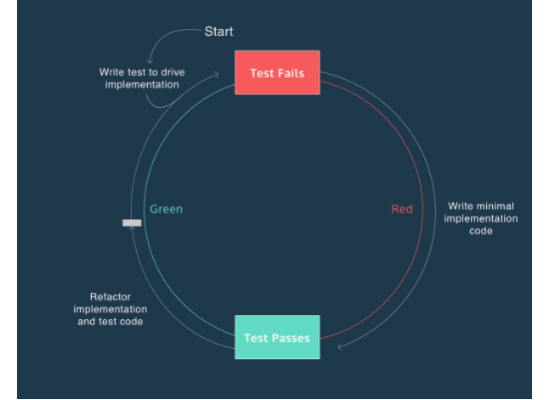
Step 3: Develop
The Loop within a Loop
While ATDD guides the overall feature behavior, developers use TDD (Test Driven Development) for the implementation details.
Red: The X-ray Cucumber test fails initially.
Green: Write just enough code to pass the acceptance criteria.
Refactor: Clean up the code while keeping tests passing.

Slide 10
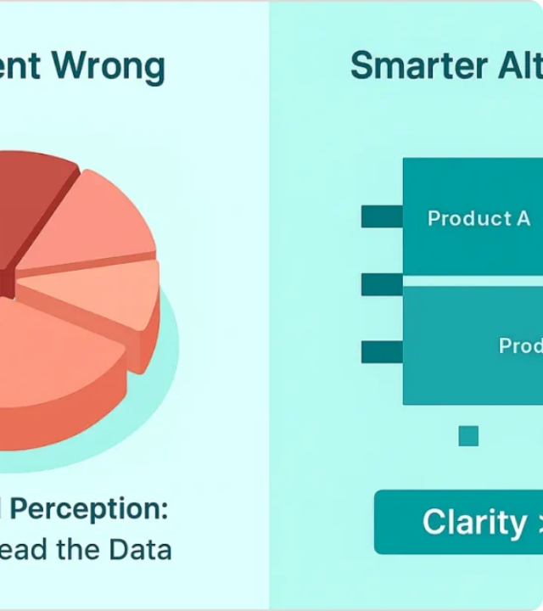
Step 4: Demo & Report
How do we prove we are done? We check the X-ray reports.
The Requirement Coverage report in JIRA visualizes the status of your User Story based on the latest Test Execution.
OK = All linked tests passed.
NOK = At least one test failed.

Slide 11




Common Pitfalls to Avoid
What Goes Wrong
Best Practices
Writing tests in isolation (Silos).
Involve QA at the very start.
Using UI-focused steps instead of business logic.
Keep scenarios concise and readable.
Ignoring "Red" builds in the CI pipeline.
Treat test code with the same care as production code.

